Slide 1
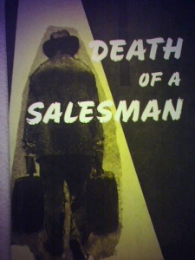
Death of a Salesman
And The American Dream

Slide 2
Moonlight:
Ahlam Abdullah Ali
Hanan Al-Gahtani
Khoulod Al-Nahdi
Shaza Al-Zahrani
Tahani Al-Ghamdi

Slide 3
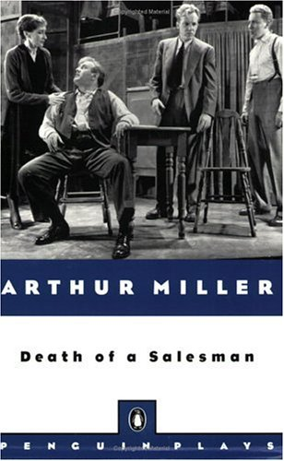
Arthur Millers Death of Salesman by
Written by :Arthur Miller
Characters :
Willy Loman ,Linda Loman ,
Biff Loman , Happy Loman .
Date premiered : 10 February 1949
Place premiered :
Morosco Theatre ,New York City
Original language : English
Subject : The waning days of a failing salesman
Genre : Tragedy
Setting: Late 1940s; Willy Loman's house; New York City and Barnaby River

Slide 4
Short summary for the play
Willy Loman is the protagonist of the “Death of salesman” play .
He is 60years old traveling salesman. He has a wife called Linda and two sons , Biff and Happy.
Through out his life he attempt to show to his sons the keys to success.
In the end Willy become a broken man whose life became sad failure. So Willy killed him self by crash with his car so that Biff can use the insurance money to start his own business But the insurance company knew that it was a suicide so they didn’t give them any thing , also few people come to his funeral.

Slide 5

What is The American Dream?
The term was first used by James Truslow Adams in his book The Epic of America which was written in 1931.

Slide 6
The term “American Dream” is used in a number of ways, but essentially the American Dream is an idea which suggests that all people can succeed through hard work, and that all people have the potential to live happy, successful lives.
Many people believe that the structure of American society belies the idealistic goal of the American Dream, pointing to examples of inequality rooted in class, race, and ethnic origin which suggest that the American Dream is not attainable for all.

Slide 7
American dream in this play
Willy represents Every low-man in America. Hence, it's a tragedy of every American. The play is really a challenge to the American Dream because it is a tragedy of a man troubled by the society. Willy believes in American myth that " success is obtained by being well-liked". His dream ends up in nightmare. So the play challenges to new American capitalistic concepts.

Slide 8
Within the tragic play, Death of a Salesman, Willy Loman destroys himself trying to achieve a dream. Yet, the dream that destroys Willy is not one that he has chosen. Willy Loman does not choose this destructive dream because he does not know himself, Willy Loman does not choose a dream at all, one is forced upon him by society.

Slide 9
Willy Loman spends the expanse of the play trying to achieve wealth, fame, and the like of others. Willy's true dream, however, was very different from this. Throughout the play you can see evidence that Willy feels trapped by this dream that he feels obligated to fulfill. Society has dictated to Willy that the American Dream is "the" dream, and no other dream is acceptable. Because of this dictation, Willy abandons his true dream of living on his own, in the country, where he can support himself by farming, and living from the land.

Slide 10
In the climax of the play, when Willy realizes that he is loved by his sons, a slight awakening occurs in Willy's mind. He begins to understand that his true dream, of living in the country, is identical to that of his beloved son, Biff.
Biff has never been able to follow his dream because of his father pushing him into the false dream of being a businessman. Willy comprehends that he has been denying his son’s dream that he wishes to achieve, and out of pure love kills himself, giving his life insurance to his family, and completes the dream of being wealthy, hoping that by completing the false dream will free his sons of the burden to finish it for him, allowing them to create their own dreams, and then follow them with the money that Willy leaves behind.

Slide 11
Ben’s America Dream:
To Willy’s older brother Ben, the American Dream is the ability to start with nothing and somehow make a fortune:
Ben, William“when I walked into the jungle, I was seventeen. When I walked out I was twenty-one. And, by God, I was rich!”

Slide 12
Biff’s American Dream:
Although he has felt confused and angry since discovering his father’s infidelity, Biff Loman does have potential to pursue the “right” dream – if only he could resolve his inner conflict. Biff is pulled by two different dreams. One dream is his father’s world of business, sales, and capitalism. But another dream involves nature, the great outdoors, and working with his hands. Biff explains to his brother both the appeal and the angst of working on a ranch.

Slide 13
However, by the end of the play, Biff realizes that his father had the “wrong” dream. Biff understands that his father was great with his hands. Willy built their garage and put up a new ceiling. Biff believes that his father should have been a carpenter, or should have lived in another, more rustic part of the country. But instead, Willy pursued an empty life. Willy sold nameless, unidentified products, and watched his American Dream fall apart.

